Slide 1



Safety and Security
Director: Geno Trujillo
Supervisor: Melvin Moquino
Security Officers:
Gerald Rael, David Chacon,
Jared Mata, Juan Mendoza,
Heriberto Calderon, Javin Lujan

Slide 2
NNMC Safety and Security
NNMC’s campus security strategy integrates physical safeguards (cameras, access control, lighting), emergency planning, and regular training.
It emphasizes patrol visibility, rapid alert and lockdown technology, and strong coordination with local law enforcement for effective incident response.

Slide 3
NNMC Safety and Security Improvements
Integrated Systems & Technology
Surveillance & Monitoring: We have upgraded our security cameras to enable real-time
monitoring of activities and to deter crime (El Rito).
Emergency Notification: The Eagle Alert system has been improved to quickly disseminate urgent safety information to the entire campus community.
Blue-Light Phones: While the technology for our emergency call stations (blue-light phones) is outdated, we ensure they remain operational throughout the campus to provide immediate assistance when needed.

Slide 4
NNMC Safety and Security Improvements
Physical Security & Environment
Lighting and Patrols: We ensure that high-traffic areas, such as walkways and parking lots, are well-lit to improve visibility, deter criminal activity, and enhance safety. Additionally, we have increased the visibility of trained security personnel through regular patrols.
Access & Entry Points: Our goal is to limit building access during operational hours to facilitate quick lockdowns when necessary.
Landscaping: We maintain the campus grounds and trim shrubs to eliminate hiding
spots and enhance visibility, helping to prevent crime.

Slide 5
NNMC Safety and Security Improvements
Emergency Plans: We have developed comprehensive emergency plans for various scenarios, including natural disasters and active threats, outlining clear protocols for evacuation and sheltering.
Drills and Training: We conduct regular drills for various emergencies (e.g., fire, active shooter, lockdown) to ensure preparedness and identify areas for improvement in our security protocols.
Staff Training: Ongoing training is provided to security personnel to equip them with
the skills necessary to effectively utilize new technology and respond to incidents.
Campus Safety Education: We educate students and staff on safety tips, such as
locking doors, securing personal belongings, and practicing effective bystander
communication to help prevent incidents.

Slide 6
NNMC Espanola Safety and Security Proposals
Proposed Advanced Security Training - Estimated annual cost: $15,000.00
The Safety and Security Director has identified the need for ongoing advanced training to strengthen staff preparedness.
Proposed Campus Perimeter Security - Estimated cost: $1,663,007.26 (Valley Fence)
To improve boundary control and reduce daily security risks.
Proposed Fire & Life Safety Upgrades - Estimated cost: $1,200,000 (Honeywell)
To ensure compliance and strengthen life safety systems.
Proposed Integrated Systems & Technology - Estimated cost: $1,214,759.55 (APIC)
To improve campus surveillance, monitoring, and access control.
Notes:
Additional improvements:

Slide 7
NNMC CAMPUS SAFETY AND SECURITY SNAPSHOT
NNMC reported 0 on-campus Clery crimes in 2023
Peers:
  NMSU–Grants: 0
  UNM–Gallup: 1 (Domestic Violence)
  NMHU: 2 (Domestic Violence &
  Dating Violence)
Rates per 1,000 students:
  NNMC → 0.00
  NMSU–Grants → 0.00
  UNM–Gallup → 0.41
  NMHU →0.70
Internal log (broader than Clery):
  2023: 8 incidents
  2024: 19 incidents
  2025 YTD: 12 incidents
Most frequent: Larceny/Theft, Vandalism,
Disorderly Conduct
NNMC is very safe relative to peers; proactive monitoring continues.

Slide 8
NNMC CAMPUS SAFETY AND SECURITY SNAPSHOT
Campus (approx. Fall ‘24 headcount) | 2023 on-campus Clery primary crimes* | Rate per 1,000 students
Northern New Mexico College (≈1,386) | 0 | 0.00
NMSU – Grants (≈754) | 0 | 0.00
UNM – Gallup (≈2,424) | 1 (Domestic Violence) | 0.41
NMHU | 2 (Domestic Violence and Dating Violence) | 0.70
* “Primary crimes” = murder, manslaughter, rape, fondling, incest, statutory rape, robbery, aggravated assault, burglary, motor vehicle theft, arson. VAWA offenses (dating/domestic violence, stalking) are also reported in Clery tables and are included here when they occurred on campus.
NNMC is at or below comparable NM peers on Clery-defined on-campus crime in 2023, with a zero incident count (same as NMSU-Grants and lower than UNM-Gallup’s single VAWA case and NMHU 2 incidents).

Slide 9
NNMC CAMPUS SAFETY AND SECURITY SNAPSHOT
Data Summary:
Clery benchmark (2023): NNMC reported zero on-campus Clery crimes in 2023, matching NMSU-Grants and outperforming UNM-Gallup (which reported one on-campus VAWA incident) and NMHU (which reported two on-campus incidents). On a per-1,000 student basis, our rate is 0.00, which compares favorably within our peer group. (nmsupolice.com, Luna Community College, Office of Institutional Analysis, hed.nm.gov)
Operational vigilance: Our internal log shows typical two-year variability (8 → 19 → 12 YTD) driven mainly by larceny/theft and vandalism. While most entries are not Clery-reportable crimes, they inform staffing, patrol patterns, lighting/camera placement, and prevention programming.
Conclusion: By federal Clery standards, NNMC is very safe relative to peers. We continue to invest in prevention and rapid response to keep operational incidents low and non-serious.

Slide 10
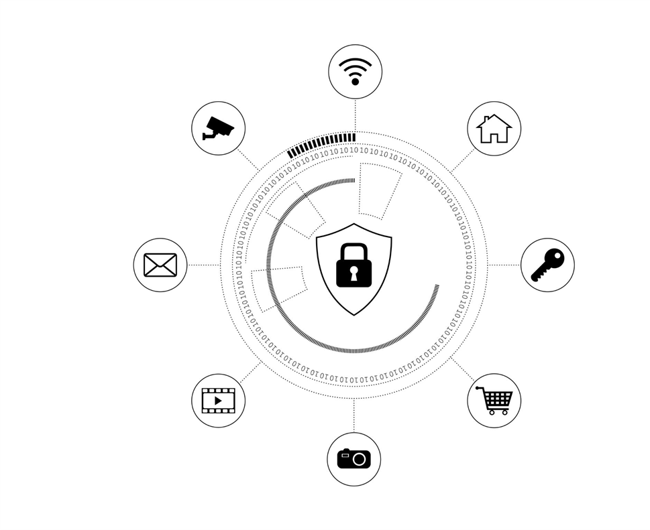
The Interconnected Pillars of Campus Safety
Defining the Pillars
Campus Safety: The overall well-being and security of the entire campus community—students, faculty, and staff.
Campus Security: Focuses on the physical environment.
Examples: Security personnel, surveillance cameras, emergency call boxes, building access control, and patrol vehicles.
Cyber Security: Focuses on the digital environment.
Examples: Protecting campus networks, student and faculty data, financial records, online learning platforms, and college research from digital threats.

Slide 11
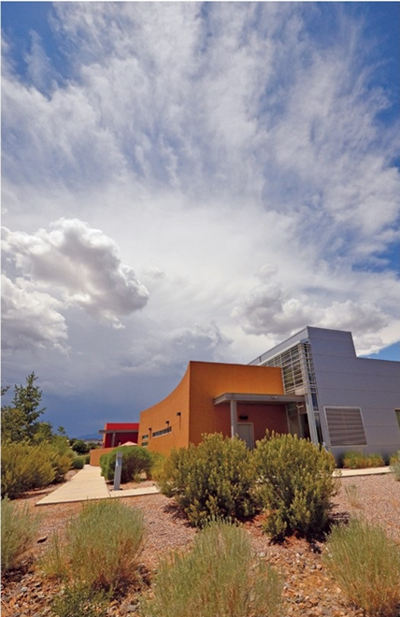
Campus Security: The Physical Shield 🛡️
Role: To deter and respond to physical threats.
Core Functions:
Monitoring and controlling physical access to buildings and sensitive areas.
Patrolling campus to maintain a visible security presence.
Responding to emergencies such as medical incidents, fires, and violent acts.

Slide 12

Cyber Security: The Digital Fortress 💻
Role: To protect the college’s digital assets and infrastructure.
Core Functions:
Preventing unauthorized access to confidential data.
Defending against malware, phishing attacks, and data breaches.
Ensuring the integrity and availability of essential online systems.

Slide 13
Where the Two Worlds Connect 🌐
Physical Security Relies on Digital Systems: Modern physical security systems are increasingly controlled by digital systems.
Breach Example: A cyber attack on the campus security system could disable surveillance cameras or unlock building doors, creating a physical safety risk.
Digital Data Can Lead to Physical Harm: A data breach exposing sensitive student information (addresses, schedules, financial details) can put individuals at risk of identity theft, fraud, and even physical stalking.
Emergency Communications are Integrated: The systems used to send out emergency alerts (text messages, email, public address systems) are IT-based. A cyber attack could prevent critical warnings from being sent out, delaying a response to a

Slide 14
NNMC ID Rollout: Enhanced Security
The rollout of NNMC ID, a new single sign-on (SSO) solution, is a major step forward for campus security. By centralizing the authentication process, it provides a stronger, more secure digital environment for students and staff.
Key Security Benefits:
One Secure Login Point: NNMC ID reduces the number of credentials a user must remember to just one. This minimizes the risk of password fatigue, which often leads to users creating weak or reusing passwords across multiple applications, thereby increasing vulnerability.
Reduced Phishing: A single, trusted login page helps users avoid falling for fake login scams.
Centralized Control: Our IT team can now manage and enforce security policies, like timely deprovisioning, from one central location.
Built-in MFA: NNMC ID enables Multi-Factor Authentication, adding a critical second layer of defense to protect your account.

Slide 15
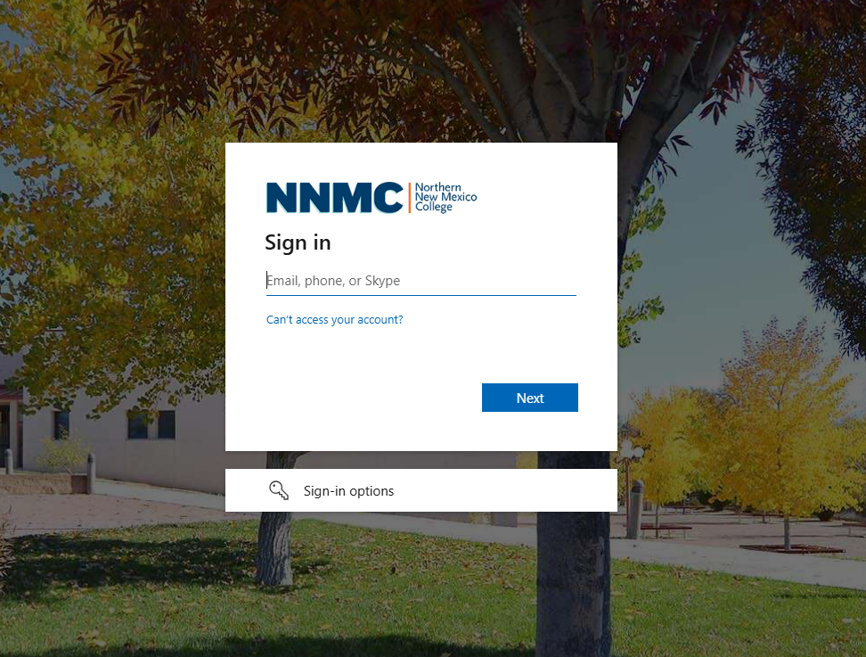
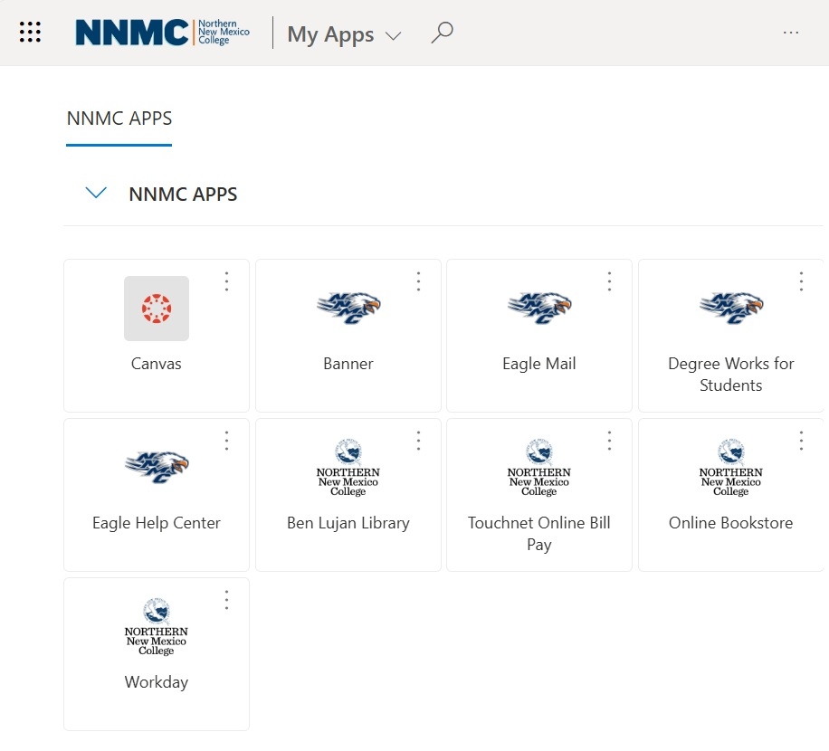
NNMC ID and NNMC APPS
Along with NNMC ID, we are introducing NNMC APPS — Your All-in-One Dashboard. This personalized, centralized hub provides a single, convenient location to access all essential applications with just one login.

Slide 16

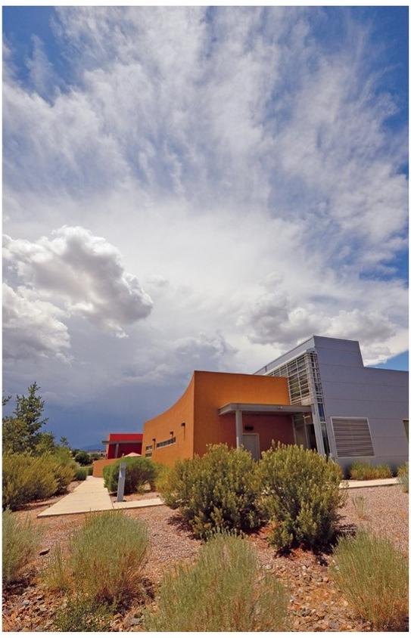
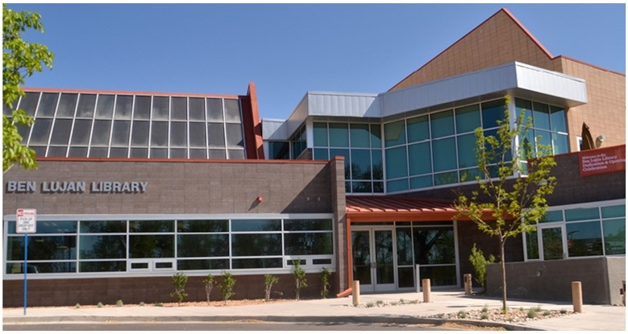
Campus Safety: The Shared Goal
Ultimately, both cybersecurity and campus security serve the same purpose: to create a secure and safe environment for the entire college community.
When both systems are strong and work together, the campus is protected from a wider range of threats, whether they are physical or digital.

