Slide 1


COLLEGIATE STUDY AWAY IN THE U.S. AND CANADA

Slide 2


NSE
HISTORY
National Student Exchange was founded in 1968 with three institutions exchanging seven students. It was a time when our nation and students on college campuses were searching to understand identity and how differences fit into the idea of American culture.

Slide 3

NSE
HISTORY
26 years ago, I participated in the NSE program for one academic year at UMASS Amherst. The experience was life-changing!!!

Slide 4


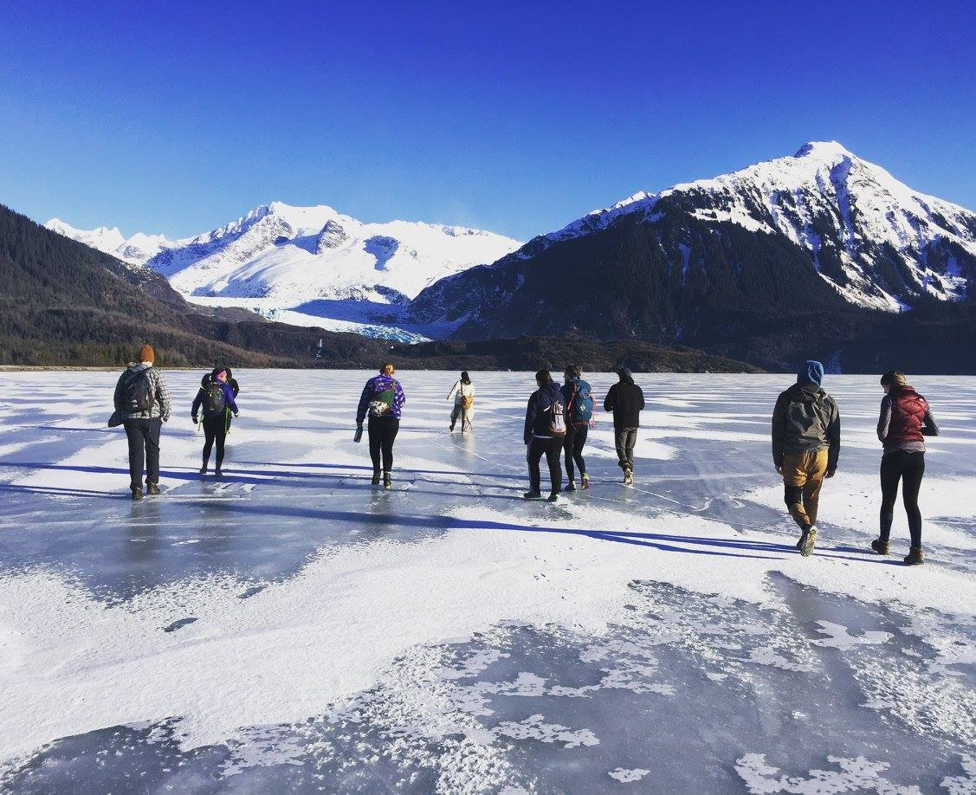


NSE
TODAY
NSE is a consortium of nearly 200 member colleges and universities that exchange students throughout the United States, Canada, Guam, Puerto Rico, and the Virgin Islands.

Slide 7


TUITION
PLAN
Home Campus Tuition Payment
  Students pay tuition/fees to their HOME campus and room/board to their host campus.
  Financial Aid: Existing financial aid awards generally apply during the exchange.

Slide 8

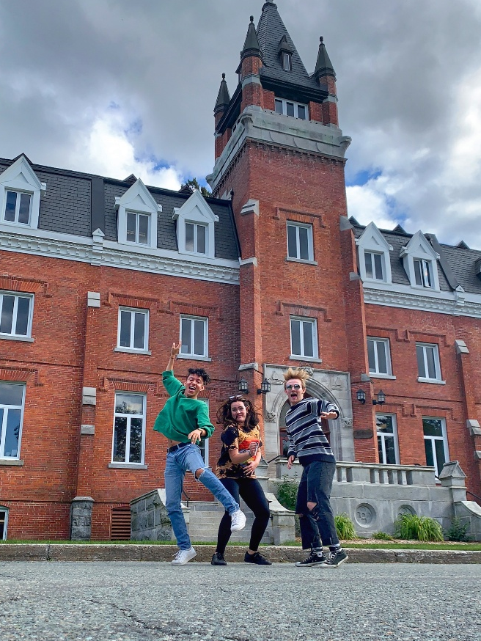



NSE?
ACADEMIC
BENEFITS
Take classes not available at home campus
Study with new professors and
experts in your field
Broaden educational perspectives
Pursue research, field study, and internship opportunities
Investigate graduate schools

Slide 9

NSE?
PROFESSIONAL
BENEFITS
Make connections in a new job market
Diversify student resume
Develop practical skills
Increase collaboration experience
Prepare yourself to live and work in a culturally diverse society

Slide 10

NSE is a Strategic fit for NNMC?
Maximizes Value: The Home pay model makes a transformative experience financially accessible.
Reduces Barriers: Provides a manageable ‘step’ into off-campus study for students new to travel or living away.
Brings Knowledge Home: Students return with new perspectives, experiences, and ideas that enrich our NNMC community.
Supports Retention & Completion: Renewed academic motivation and a clear path to degree progression.

